Slide 1
Computer Vision Final Project

Slide 2
Idea 1 – Using CV to find center of Mature Tropical Cyclone

Slide 3
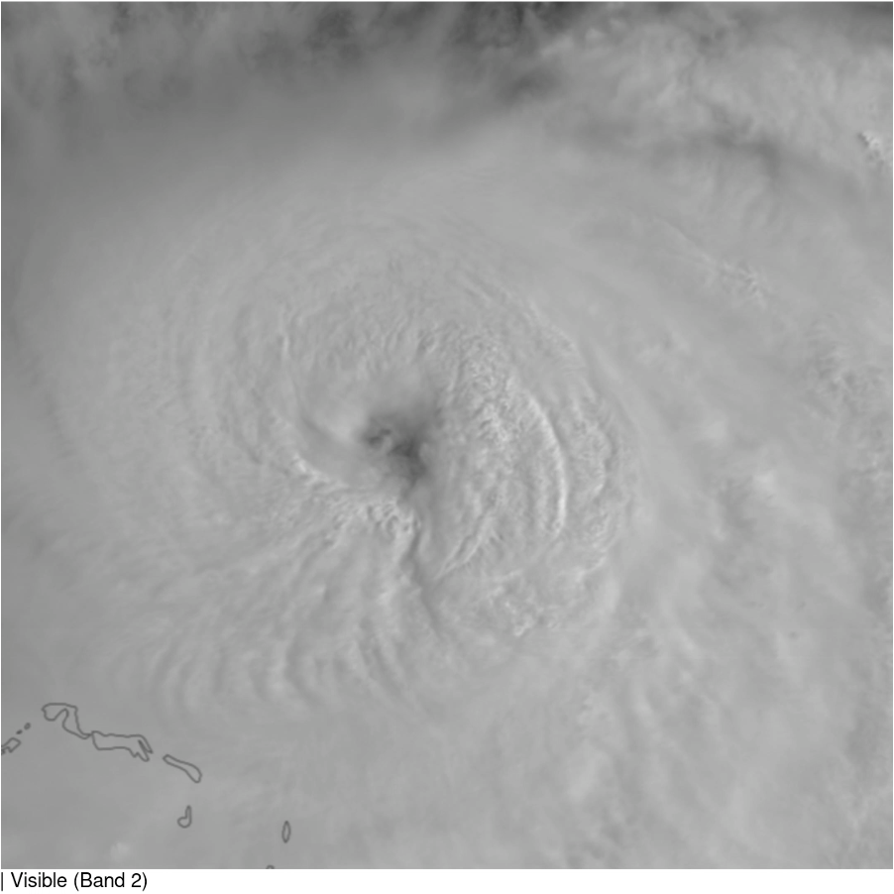
Higher-resolution track
We need more accurate and higher-temporal resolution best track data
HRD will produce a 2-minute track from aircraft observations.
Automated Rotational Center Hurricane Eye Retrieval (ARCHER) product doesn’t add a lot more temporal resolution.
ML or AI location retrievals using Particle Image Velocimetry (PIV) on geostationary satellite imagery could be used – at least in a hurricane’s mature phase.
From Steve Jayne, <sjayne@whoi.edu>

Slide 4
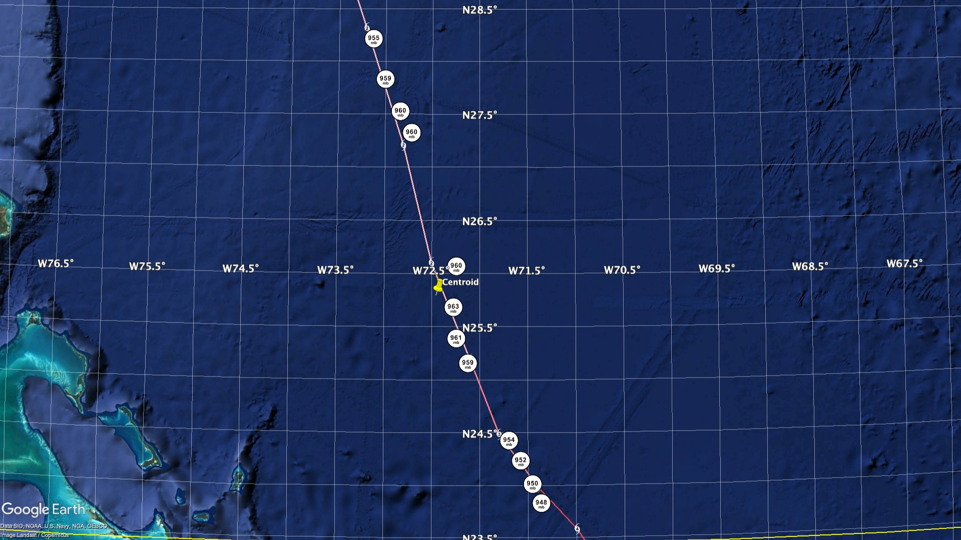
From Steve Jayne, <sjayne@whoi.edu>

Slide 5
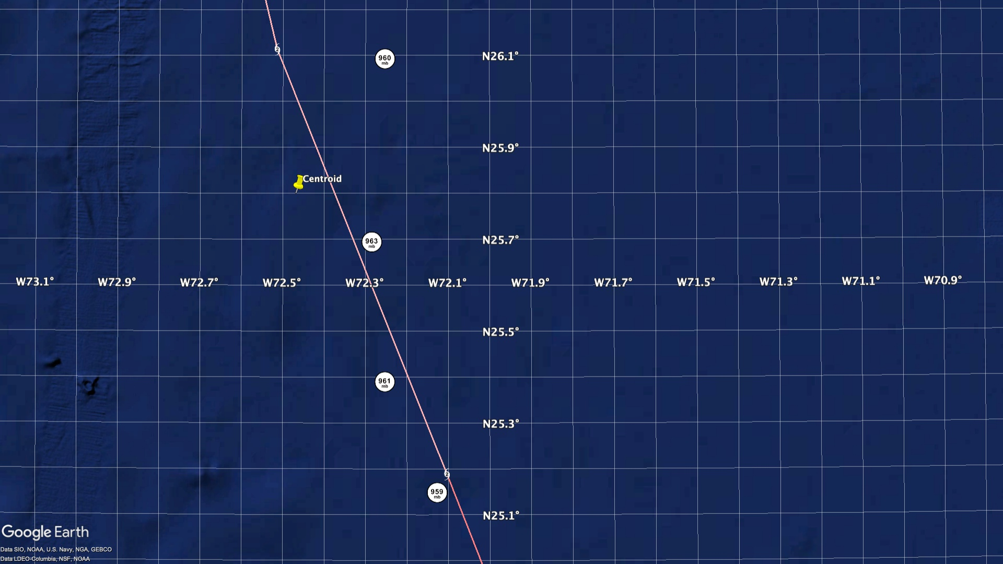
From Steve Jayne, <sjayne@whoi.edu>

Slide 6
TC relative observations
Observations are ALAMO float SST (°C) observations within 400 km of Hurricanes Irma and Florence in a storm‐centered, storm‐relative framework.
At each observation time, a range and bearing to the TC center is calculated and then plotted with bearing rotated relative to the TC motion.
Shaded arrows identify the direction of storm motion.
Sanabia & Jayne, 2020: Ocean observations under two major hurricanes: Evolution of the response across the storm wakes. AGU Advances, 1, e2019AV000161, doi:10.1029/2019AV000161.

Slide 7
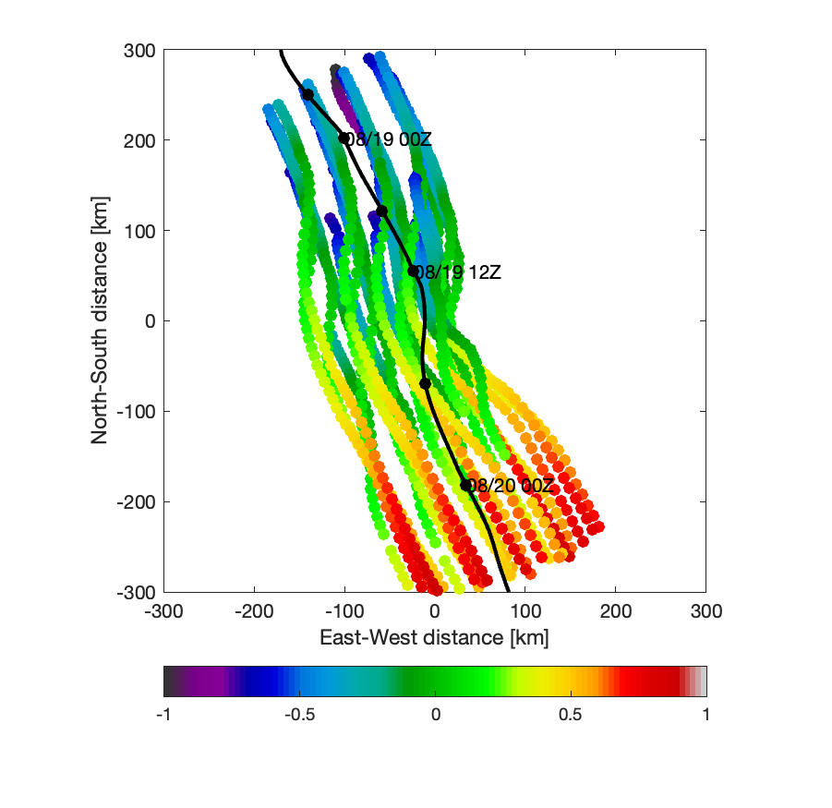
Observations over time relative to storm center
Observations are sea level pressure from all 24 A-DWSB drifters
Not rotated into storm translation direction as of now
1440 total observations covering about ±1 day of the closest approach of Erin to the array within a CPA radius of 300 km
Mostly observed the lefthand side of the storm, far fewer observations on the righthand side – track shifted to the east compared to forecast
Time relative to closest approach [days]

Slide 8
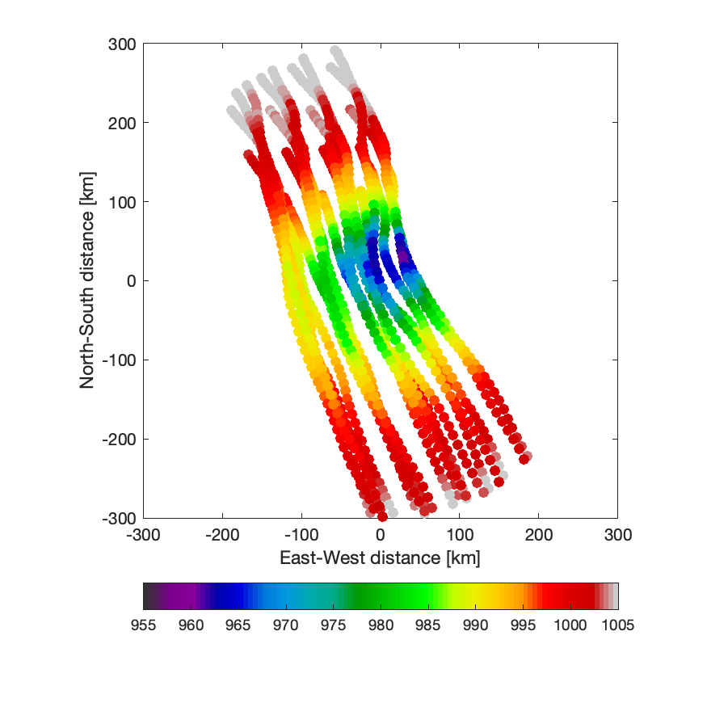
Sea level pressure reconstruction
Initial pressure reconstruction looks promising
Minimum observed pressure of 957.5 mbar (compared to 960 mbar from closest aircraft vortex message)
But looking at the details of the reconstruction reveals issues related to the exact track used to calculate ranges and bearings

Slide 9
Definition of center
Much more precise
Simple optical flow
Don’t need deep learning
Tracking – do video section by video section
Even simple tracking
Nonlinear Kalman (or even linear)

Slide 10
Even drop it an amazon turk kinda way
Ask 10 people for example
And take median

Slide 11
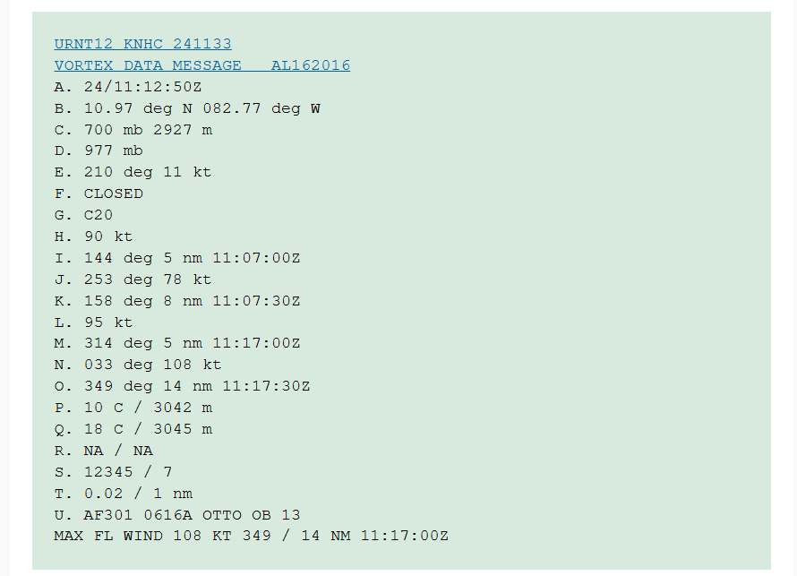
Vortex Data Message
https://learningweather.psu.edu/node/66#A

Slide 12
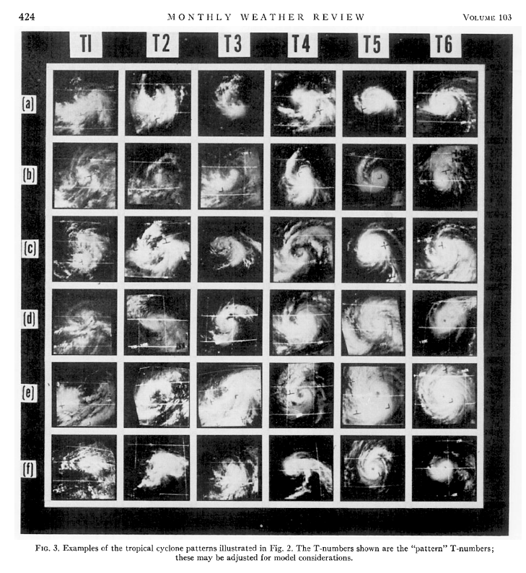
Dvorak, 1975

Slide 13
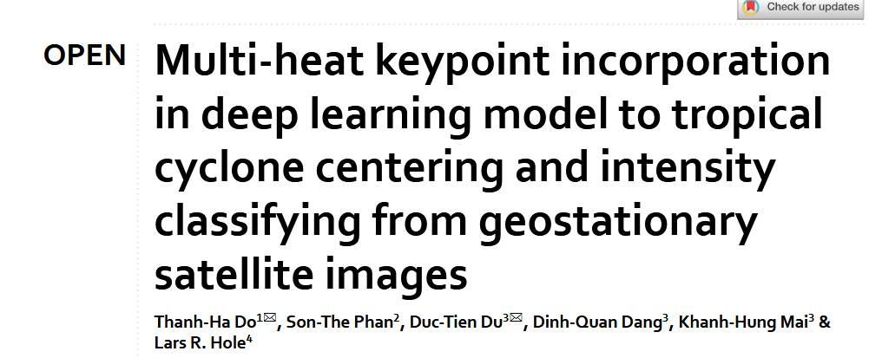
Do 2025

Slide 14
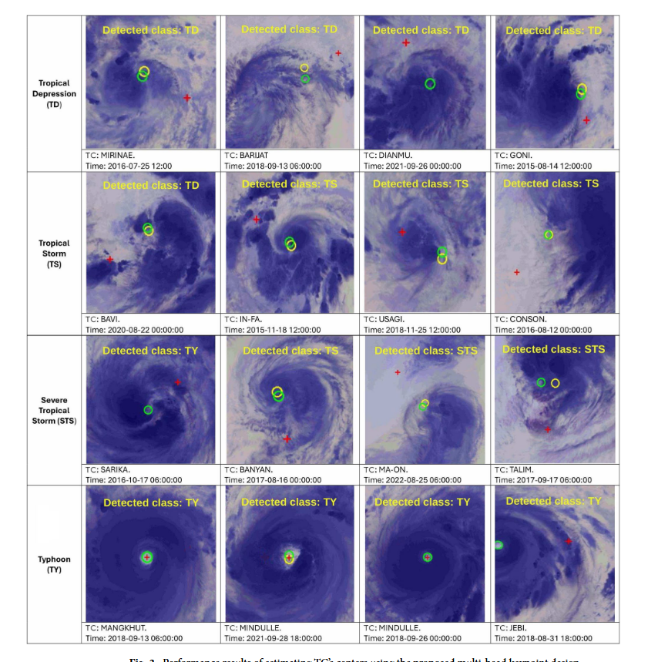

Slide 15
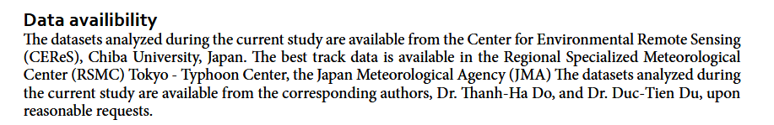

Slide 16
3D CNN
Not a temporal per say?
May want to predict curve
YLOO you look only once
Predicts up to n
Just a regression model
With video clip get
Non parametric optical flow

Slide 17
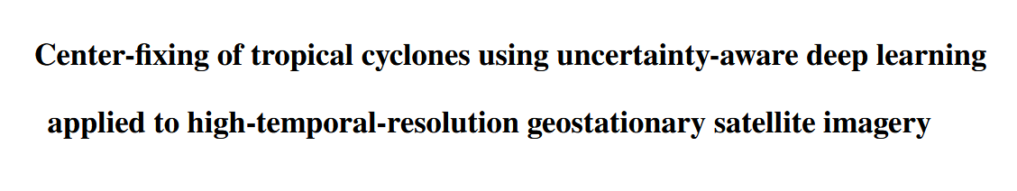
Lagerquist 2025

Slide 18
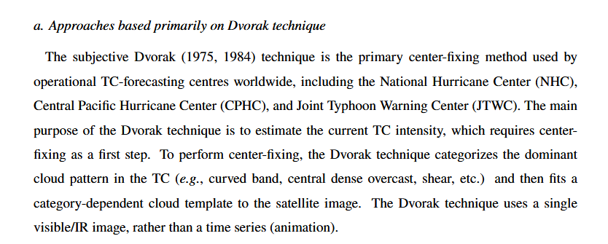

Slide 19
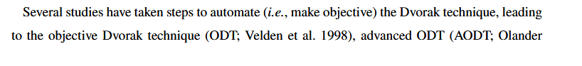
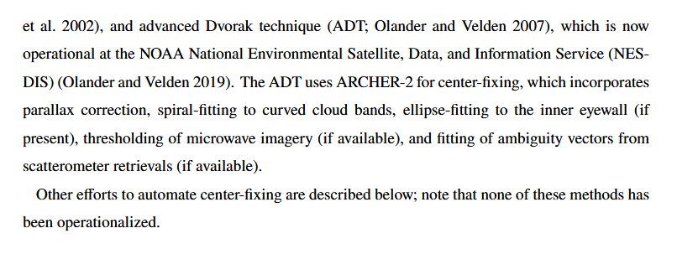

Slide 20
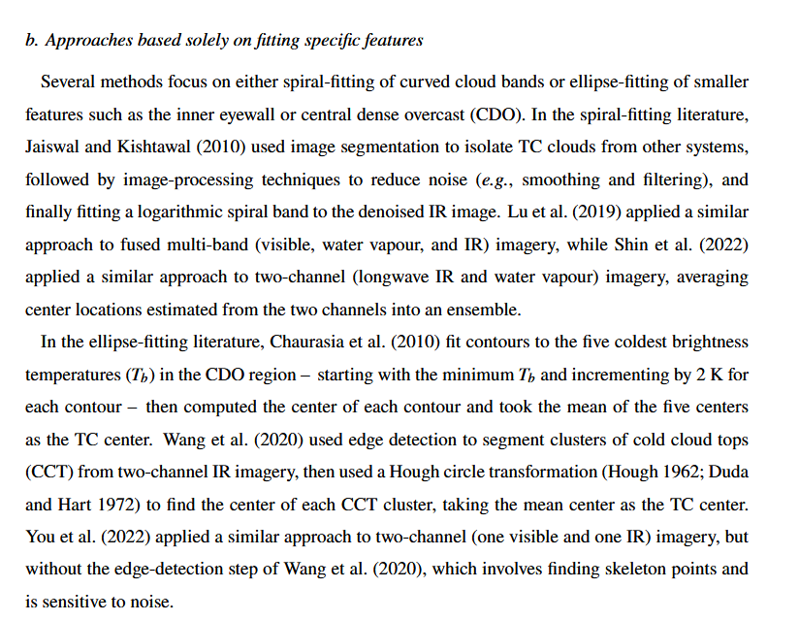

Slide 21
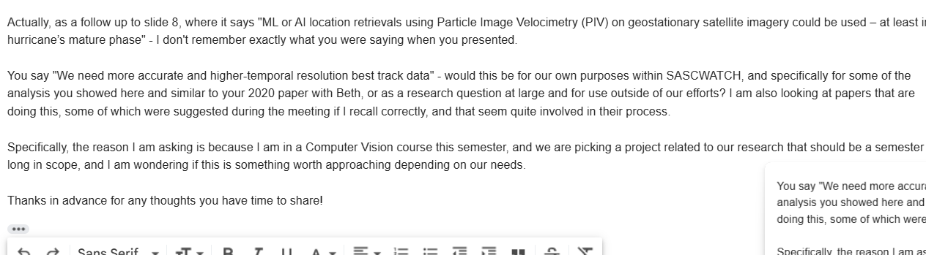

Slide 23
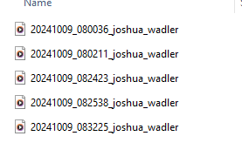
Idea 2 – getting wave field information from

Slide 24
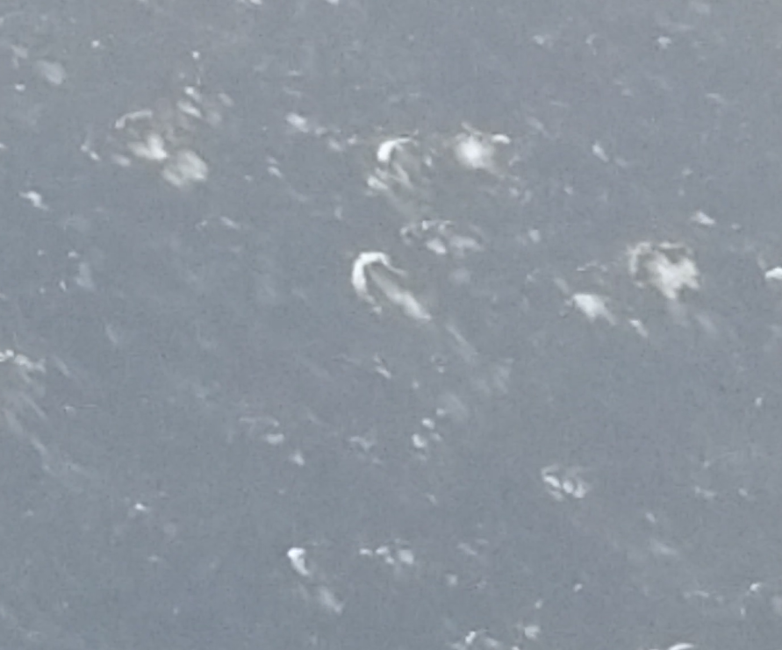

Slide 25
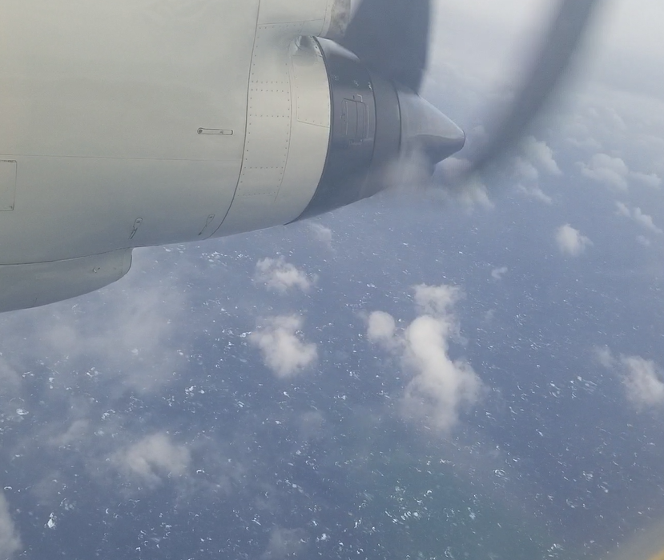

Slide 26
Bufford scale from naval

Slide 27
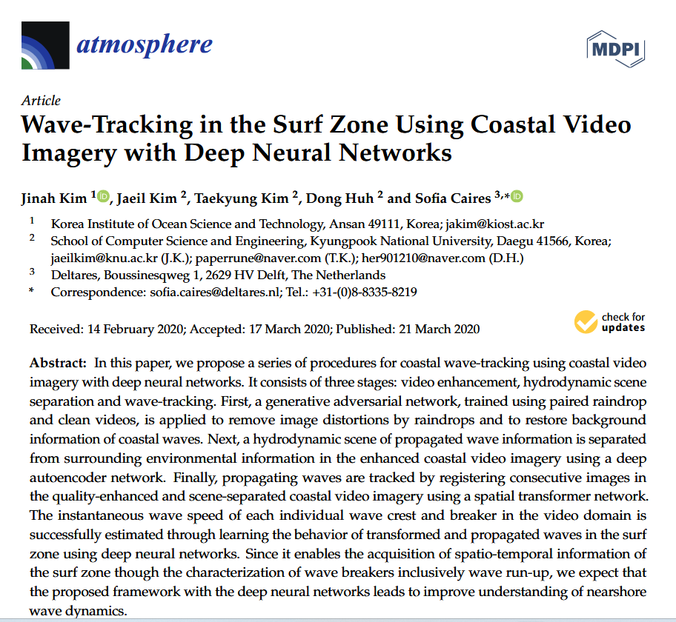

Slide 28
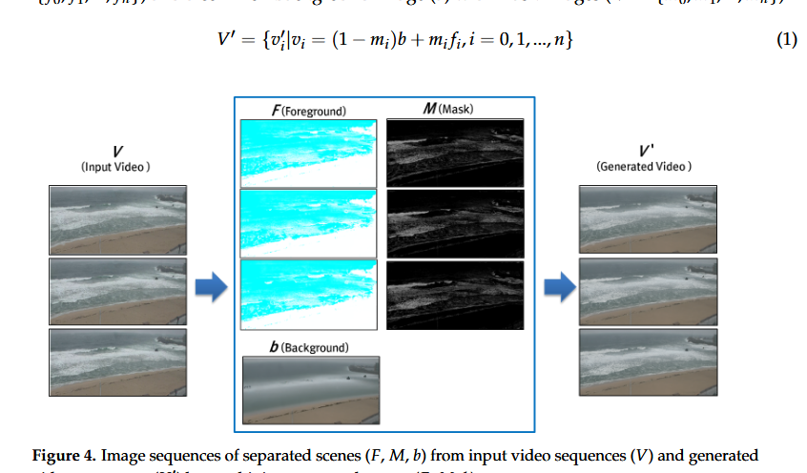

Slide 29
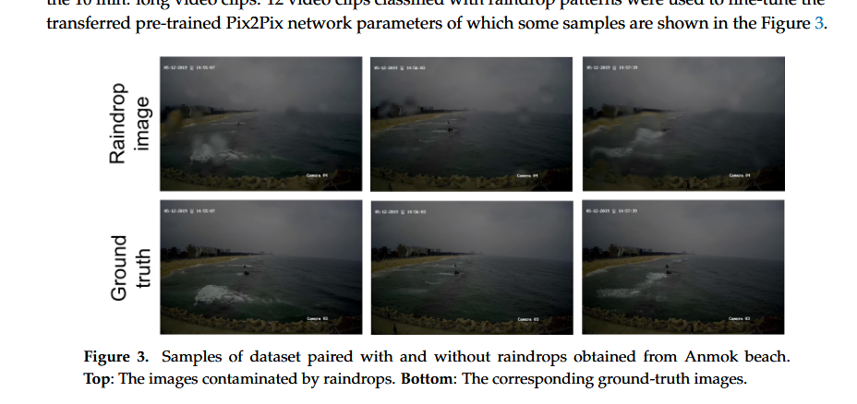

Slide 30
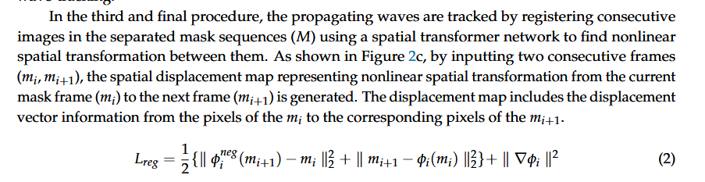

Slide 31
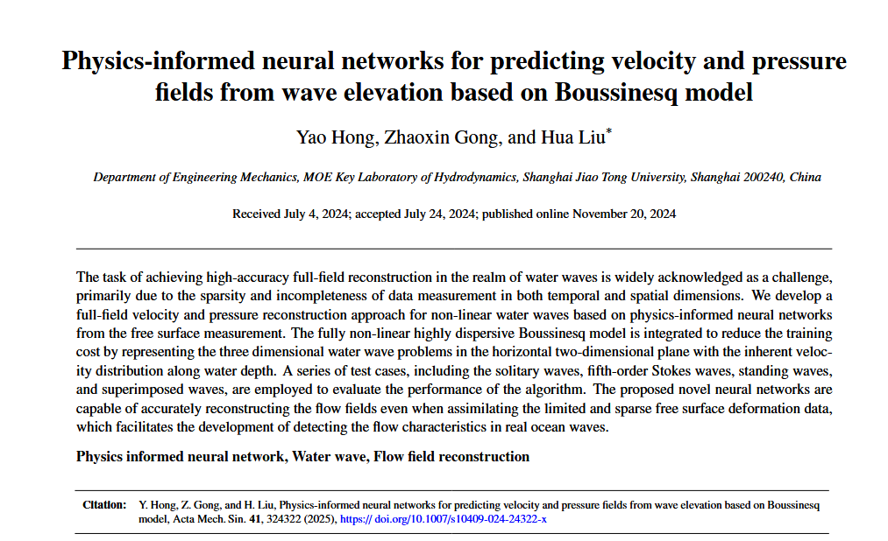

Slide 32
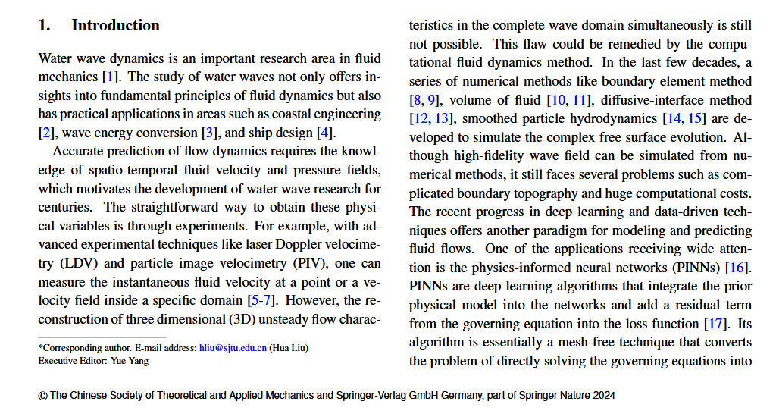

Slide 33
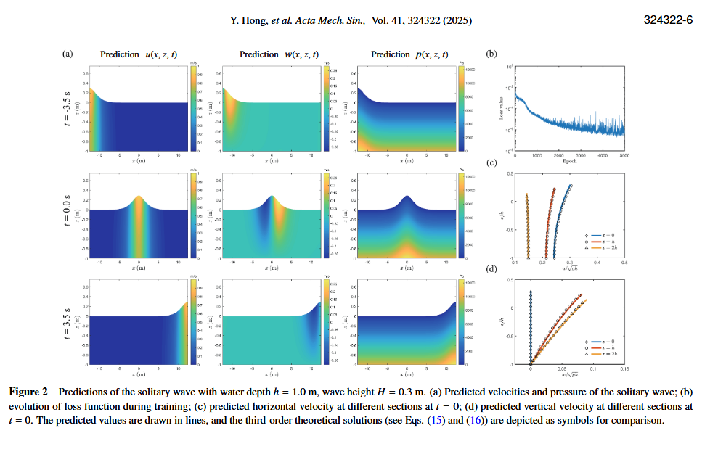

Slide 34
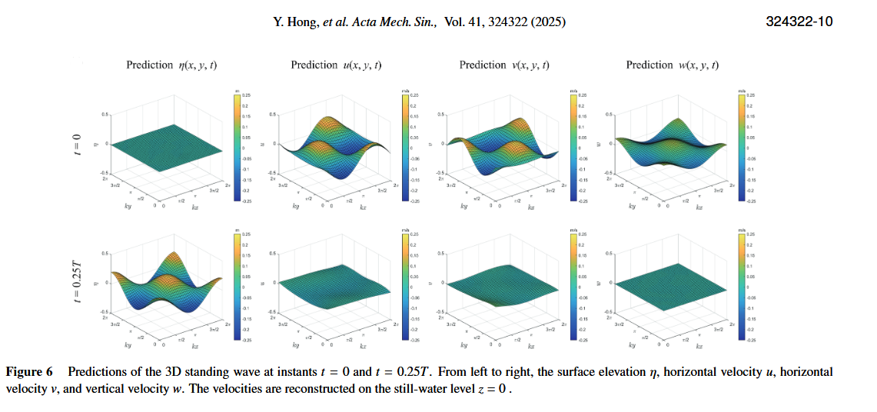

Slide 35
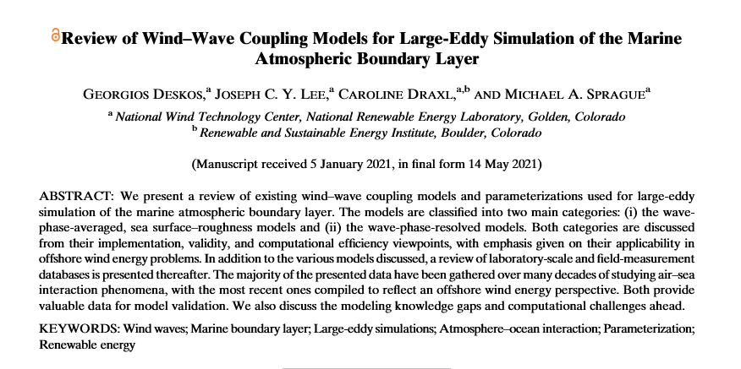

Slide 36
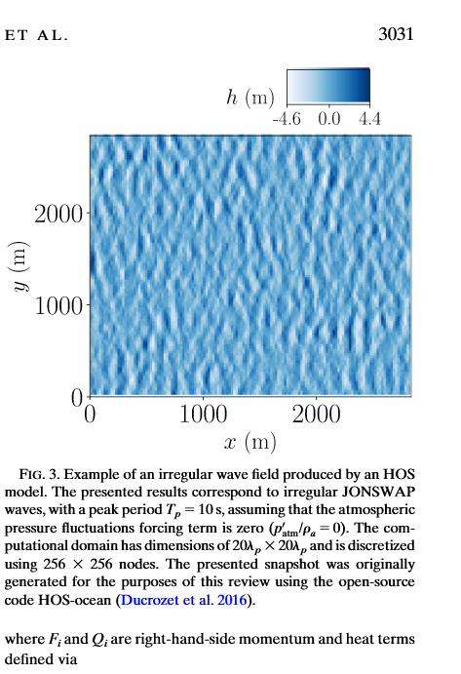

Slide 37
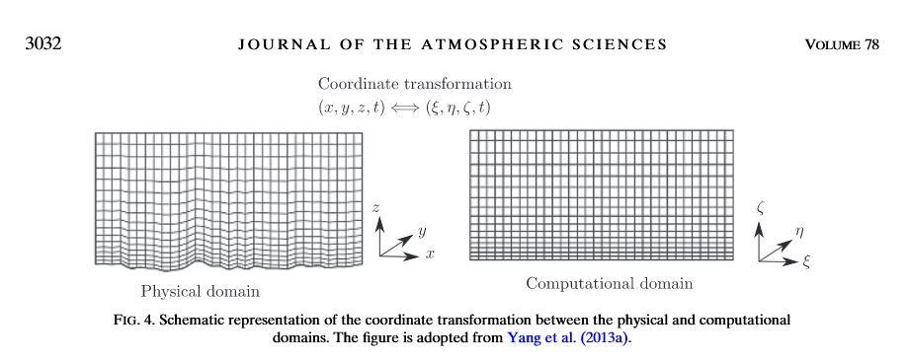

Slide 38
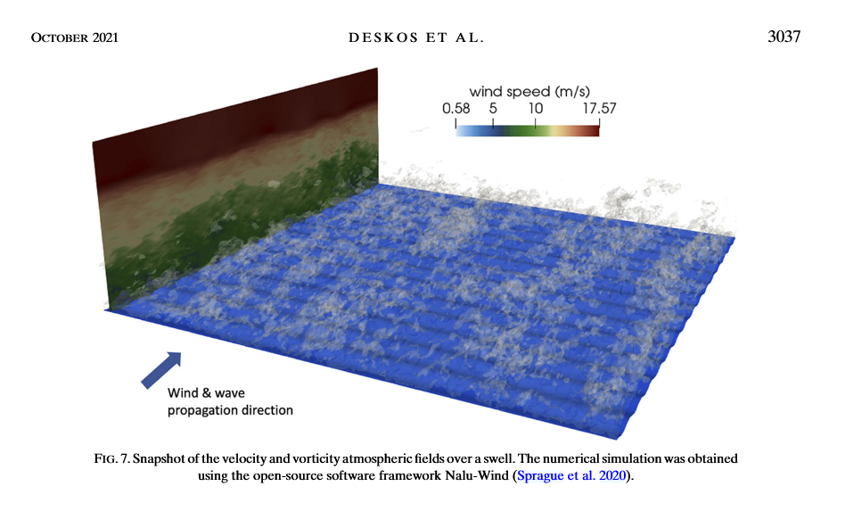

Slide 39
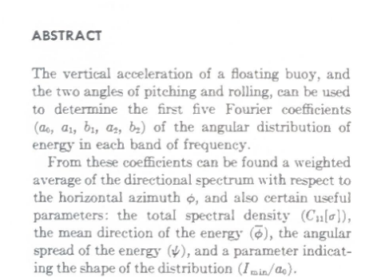
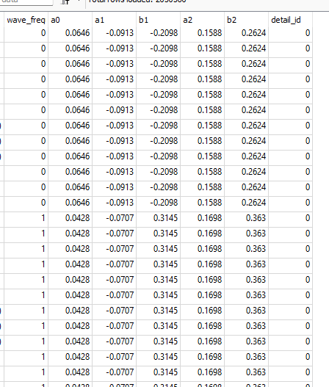
Longuet-Higgins 1963

Slide 40
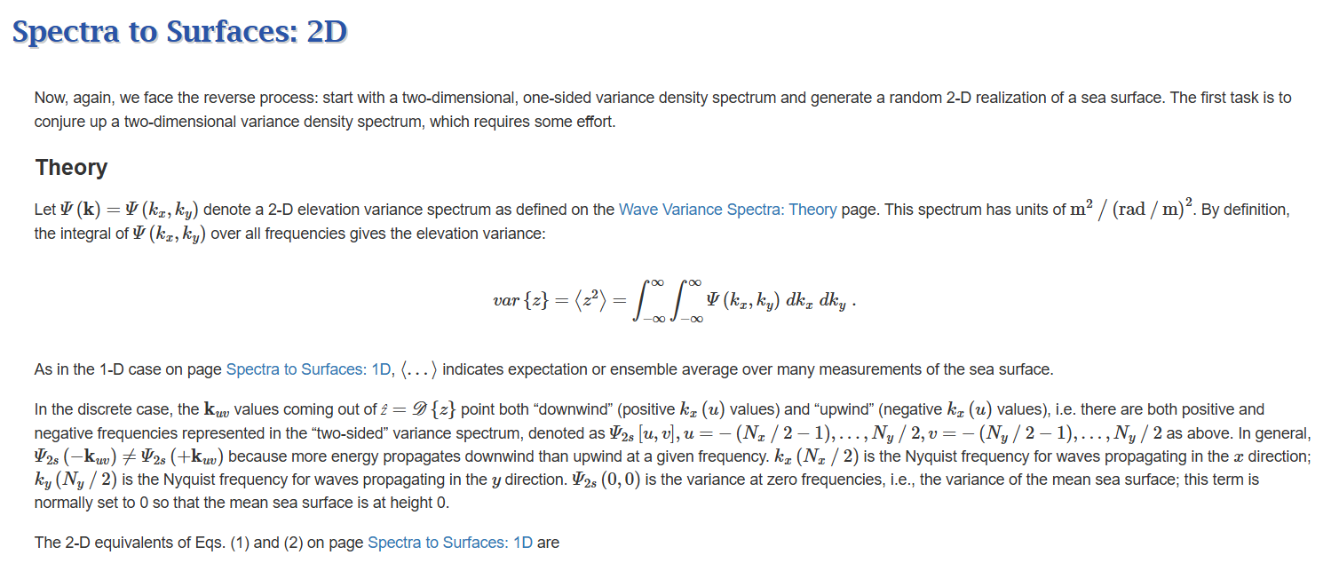

Slide 41
Waves matching
Video of waves – don’t need ground truth
Assuming simulator can give output
Calculate MSE
Now want to change parameters - calculate

